Slide 1
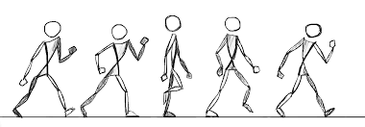
Advanced Computer Animation Term Project
Date : 2016. 12. 14
2016-27389 GYOUNG won , lee
2016-25686 inseo , jang

Slide 2
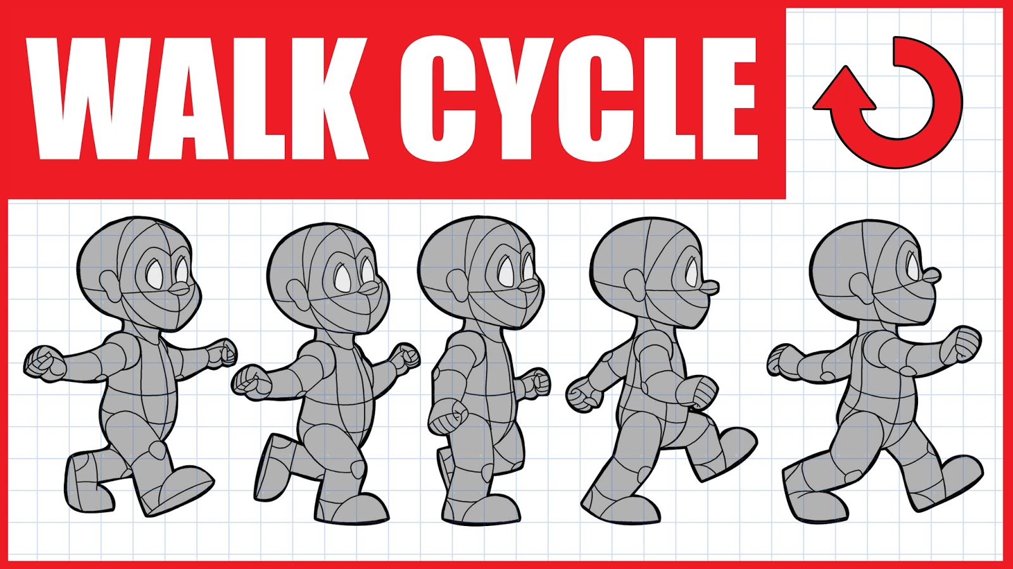

Slide 3
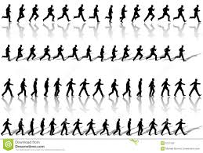

Goal
Generate Various motions
(various angles, speed )
Control motion
continuously
With Four Motion data

Slide 4
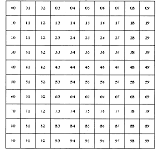
How can ?
Dynamic time warping (Motion Blending)
Angle of Direction
Using bi-linear interpolation ,
Make Blended body matrix.
Speed
Use only Four motions
(Walk straight, right ,left, stop-pose)
Generate Body matrix at once, and use this when stitching motion

Slide 5
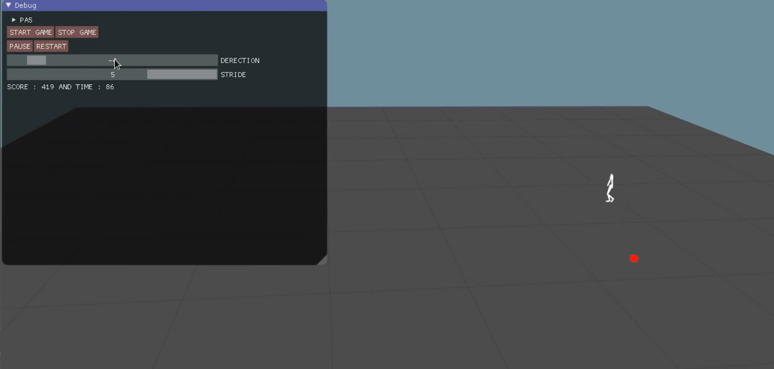
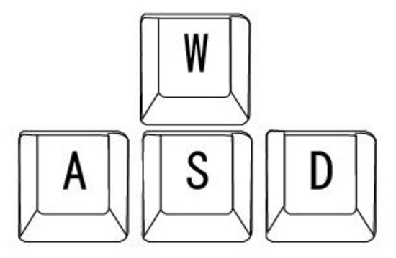
Mini Game
W : speed up
S : speed down
A ,D: control angle
Or Use slider to control motion

Slide 6
Division of Roles
Gyoung Won Lee | Interactive control User Interface Dynamic time Warping Motion blending Game programming
Inseo Jang | Game programming Interactive control Editing motion clip Report & Recording

